Slide 1
CHAPTER 15
IMAGE SEGMENTATION

Slide 2
WHAT WILL WE LEARN?
What is image segmentation and why is it relevant?
What is image thresholding and how is it implemented in MATLAB?
What are the most commonly used image segmentation techniques and how do they work?

Slide 3
Introduction
Segmentation: Partitioning an image into a set of non-overlapping regions whose union is the entire image.
These regions should ideally correspond to objects and their meaningful parts, and background.
Based on one of two basic properties that can be extracted from pixel values -- discontinuity and similarity -- or a combination of them.
One of the most crucial tasks in image processing and computer vision.
Still an open research problem.

Slide 4
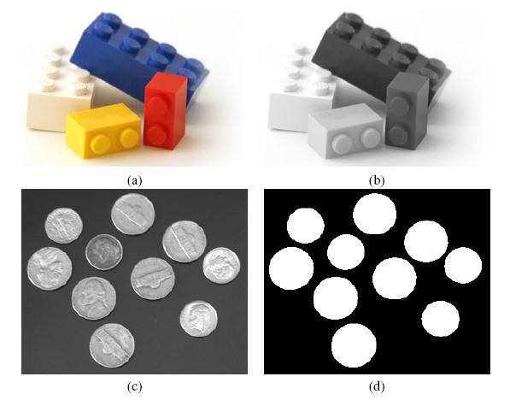
Introduction
Segmentation: easy and hard images

Slide 5
Introduction
There is no underlying theory of image segmentation, only ad hoc methods, whose performance is often evaluated indirectly, based on the performance of the larger system to which they belong.
Image segmentation techniques can vary widely according to:
type of image (e.g., binary, gray, color)
choice of mathematical framework (e.g., morphology, image statistics, graph theory)
type of features (e.g., intensity, color, texture, motion) and
approach (e.g., top-down, bottom-up, graph-based).

Slide 6
Introduction
There is no universally accepted taxonomy for classification of image segmentation algorithms, either.
In the book, we use three categories:
Intensity-based (non-contextual) methods: work based on pixel distributions (i.e., histograms).
Example: thresholding.
Region-based (contextual) methods: rely on adjacency and connectivity criteria between a pixel and its neighbors.
Examples: region growing and split-and-merge.
Other methods: these include segmentation based on texture, edges, and motion, among others.

Slide 7
Intensity-based segmentation
Rely on pixel statistics (histogram properties) to determine which pixels belong to foreground objects and which pixels should be labeled as background.
The simplest method within this category is image thresholding.

Slide 8

Image thresholding
Def.: The conversion of an image with many gray levels into another image with fewer gray levels, usually only two.
This conversion is usually performed by comparing each pixel intensity against a reference value (threshold) and replacing the pixel with a value that means ‘white’ or ‘black’ depending on the outcome of the comparison.

Slide 9
Image thresholding
Global thresholding: single value of T for the whole image
Steps:
1. Inspect the image's histogram (using imhist)
2. Select an appropriate value for T
3. Apply the selected value (using im2bw) to the image
4. Inspect the results: if they are acceptable, save resulting image; otherwise, make adjustments and repeat steps 2-4

Slide 10
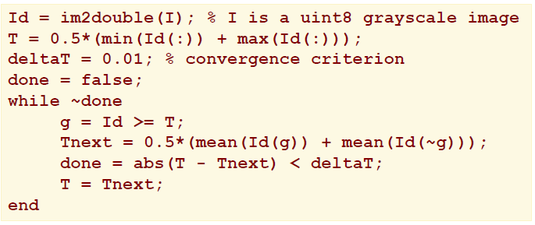
Image thresholding
Global thresholding: a procedure for selecting the best value of T automatically (Gonzalez & Woods, 2008)

Slide 11
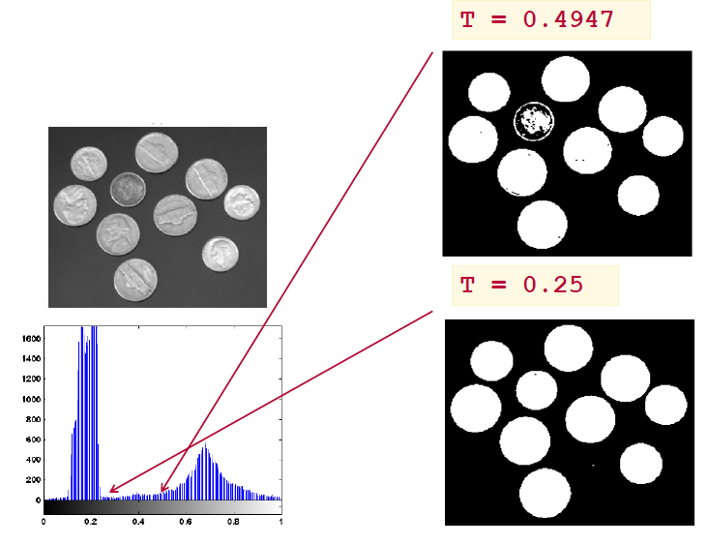
Image thresholding
Global thresholding example

Slide 12
Image thresholding
Optimal thresholding
(Otsu, 1979), implemented in the IPT as: graythresh.
For the previous example, provides the optimal value T = 0.4941

Slide 13
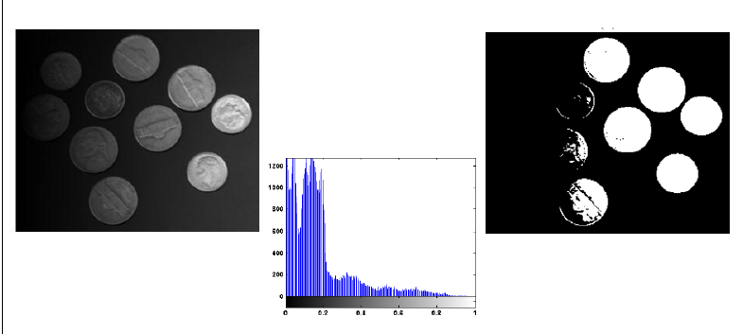
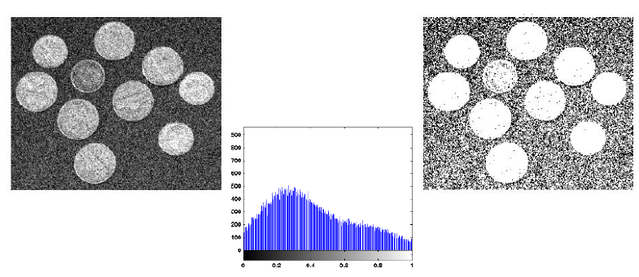
Image thresholding
The role of illumination and noise
Even easy images may become hard to segment…

Slide 14
Image thresholding

Slide 15
Local thresholding
Local (adaptive) thresholding uses block processing to threshold blocks of pixels, one block at a time.
The size of the block is usually specified by the user.
Trade-off:
If the blocks that are too small: large computational cost.
If the blocks that are too large: results may not be substantially better than the ones obtained with global thresholding.

Slide 16
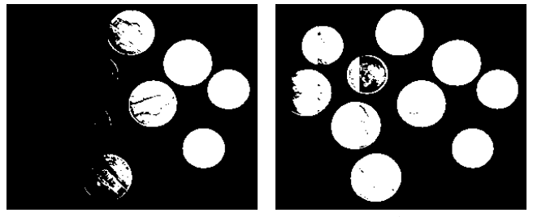
Local thresholding
Example

Slide 17
Region-based segmentation
Based on the fact that a pixel cannot be considered a part of an object or not based solely on its gray value.
Incorporate measures of connectivity among pixels in order to decide whether those pixels belong to the same region (or object) or not.

Slide 18
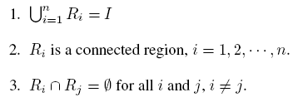
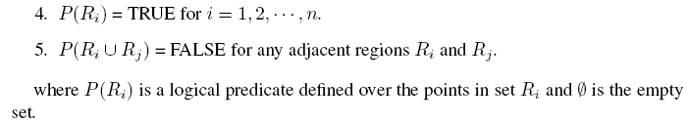
Region-based segmentation
Divide an image I into n regions R1, R2, …, Rn :

Slide 19
Region-based segmentation
Logical predicates (also called homogeneity criteria) include:
Pure uniformity
Local mean relative to global mean
Local standard deviation relative to global mean
Variance
Texture

Slide 20
Region-based segmentation
Region growing – key factors:
Choice of similarity criteria: for monochrome images, regions are analyzed based on intensity levels and connectivity properties.
Selection of seed points: these can be determined interactively (if the application allows) or based on a preliminary cluster analysis of the image, used to determine groups of pixels that share similar properties, from which a seed can be chosen.
Stopping rule: a region should stop growing when there are no further pixels that satisfy the homogeneity and connectivity criteria to be included in that region.

Slide 21
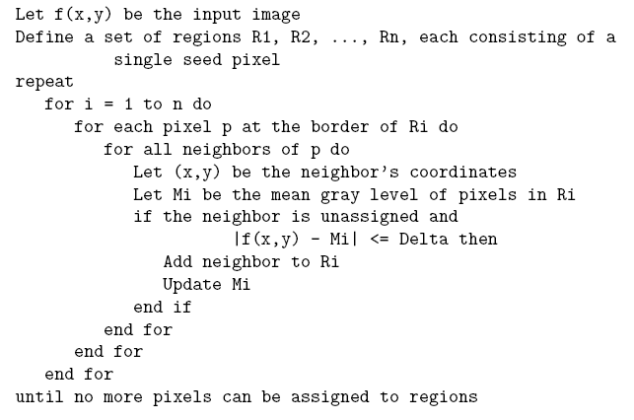
Region-based segmentation

Slide 22

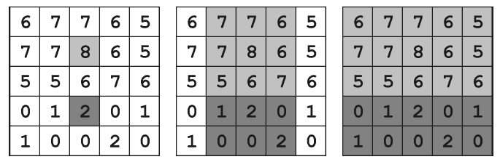
Region-based segmentation
Region growing - example

Slide 23
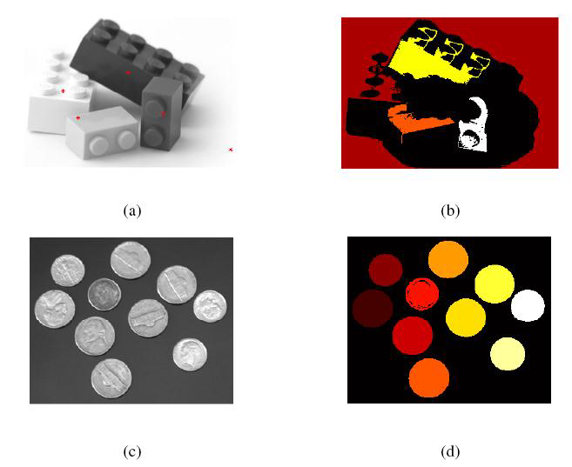
Region-based segmentation
Region growing:
additional examples

Slide 24
Region-based segmentation
Region growing – limitations:
Not very stable: significantly different results are obtained when switching between 4-connectivity and 8-connectivity criteria.
Segmentation results are very sensitive to choice of logical uniformity predicate.
The number of seeds provided by the user may not be sufficient to assign every pixel to a region.
If two or more seeds that should belong to the same region are incorrectly provided to the algorithm, it will be forced to create distinct regions around them whereas only one region should exist.

Slide 25
Region-based segmentation
Region splitting and merging
Start from the entire image and partition (split) it into smaller subimages until each resulting region is considered homogeneous by some criterion.
Merge two or more adjacent regions into one if they satisfy a homogeneity criterion.

Slide 26
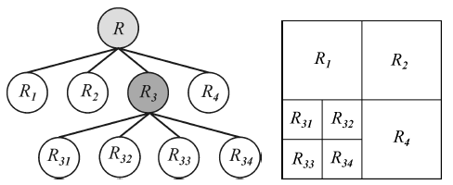
Region-based segmentation
Region splitting and merging
Data structure: quadtree, a special type of tree in which each node (except for the leaves) has four children
Each leaf node in the quadtree corresponds to a region in the segmented image

Slide 27
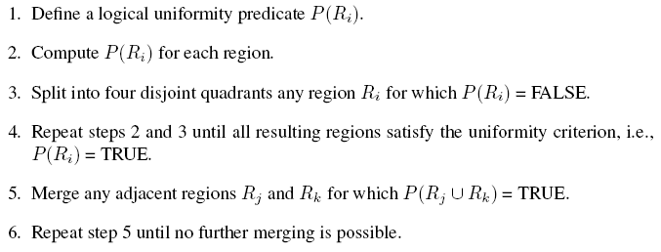
Region-based segmentation
Region splitting and merging algoritms:

Slide 28
Region-based segmentation
Morphological image segmentation algorithm (watershed)
Used to represent regions in a segmented image (equivalent to catchment basins) and the boundaries among them (analogous to the ridge lines).
In MATLAB: watershed

Slide 29
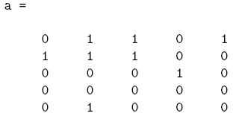
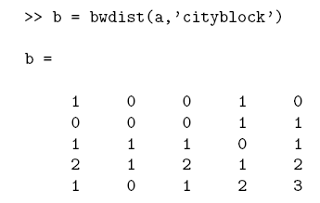
Region-based segmentation
The distance transform
Computes the distance from every pixel to the nearest nonzero-valued pixel.
In MATLAB: bwdist

Slide 30
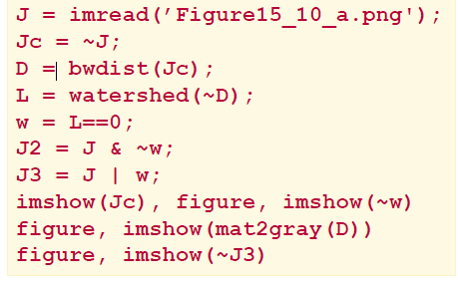
Region-based segmentation
Morphological image segmentation algorithm (watershed) – Example 15.5

Slide 31
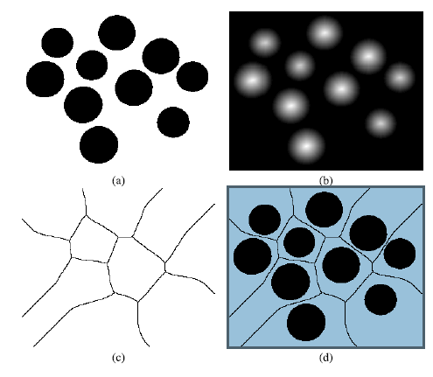
Region-based segmentation
Morphological image segmentation algorithm (watershed) – Example 15.5

Slide 32
Hands-on
Tutorial 15.1: Image thresholding (page 379)

